Slide 1



Tom Colarusso
@etcolarusso
@acvauctions
www.acvauctions.com

Slide 2

A Vue To A Kill
From AngularJS To Vue.js

Slide 3
How we got here...

Slide 4
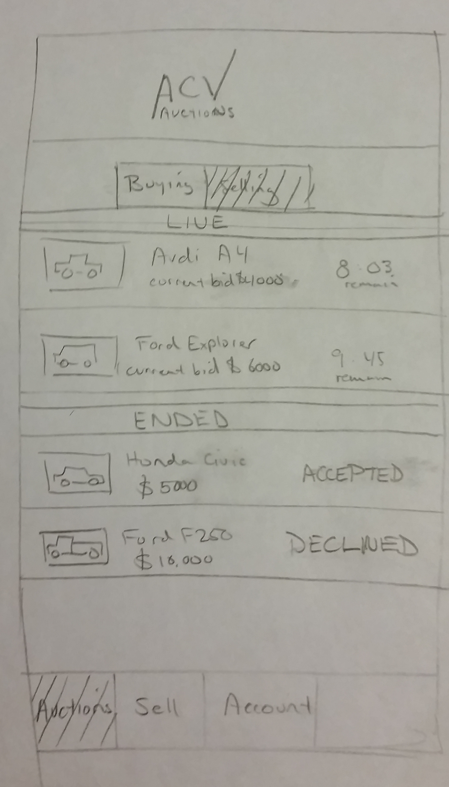
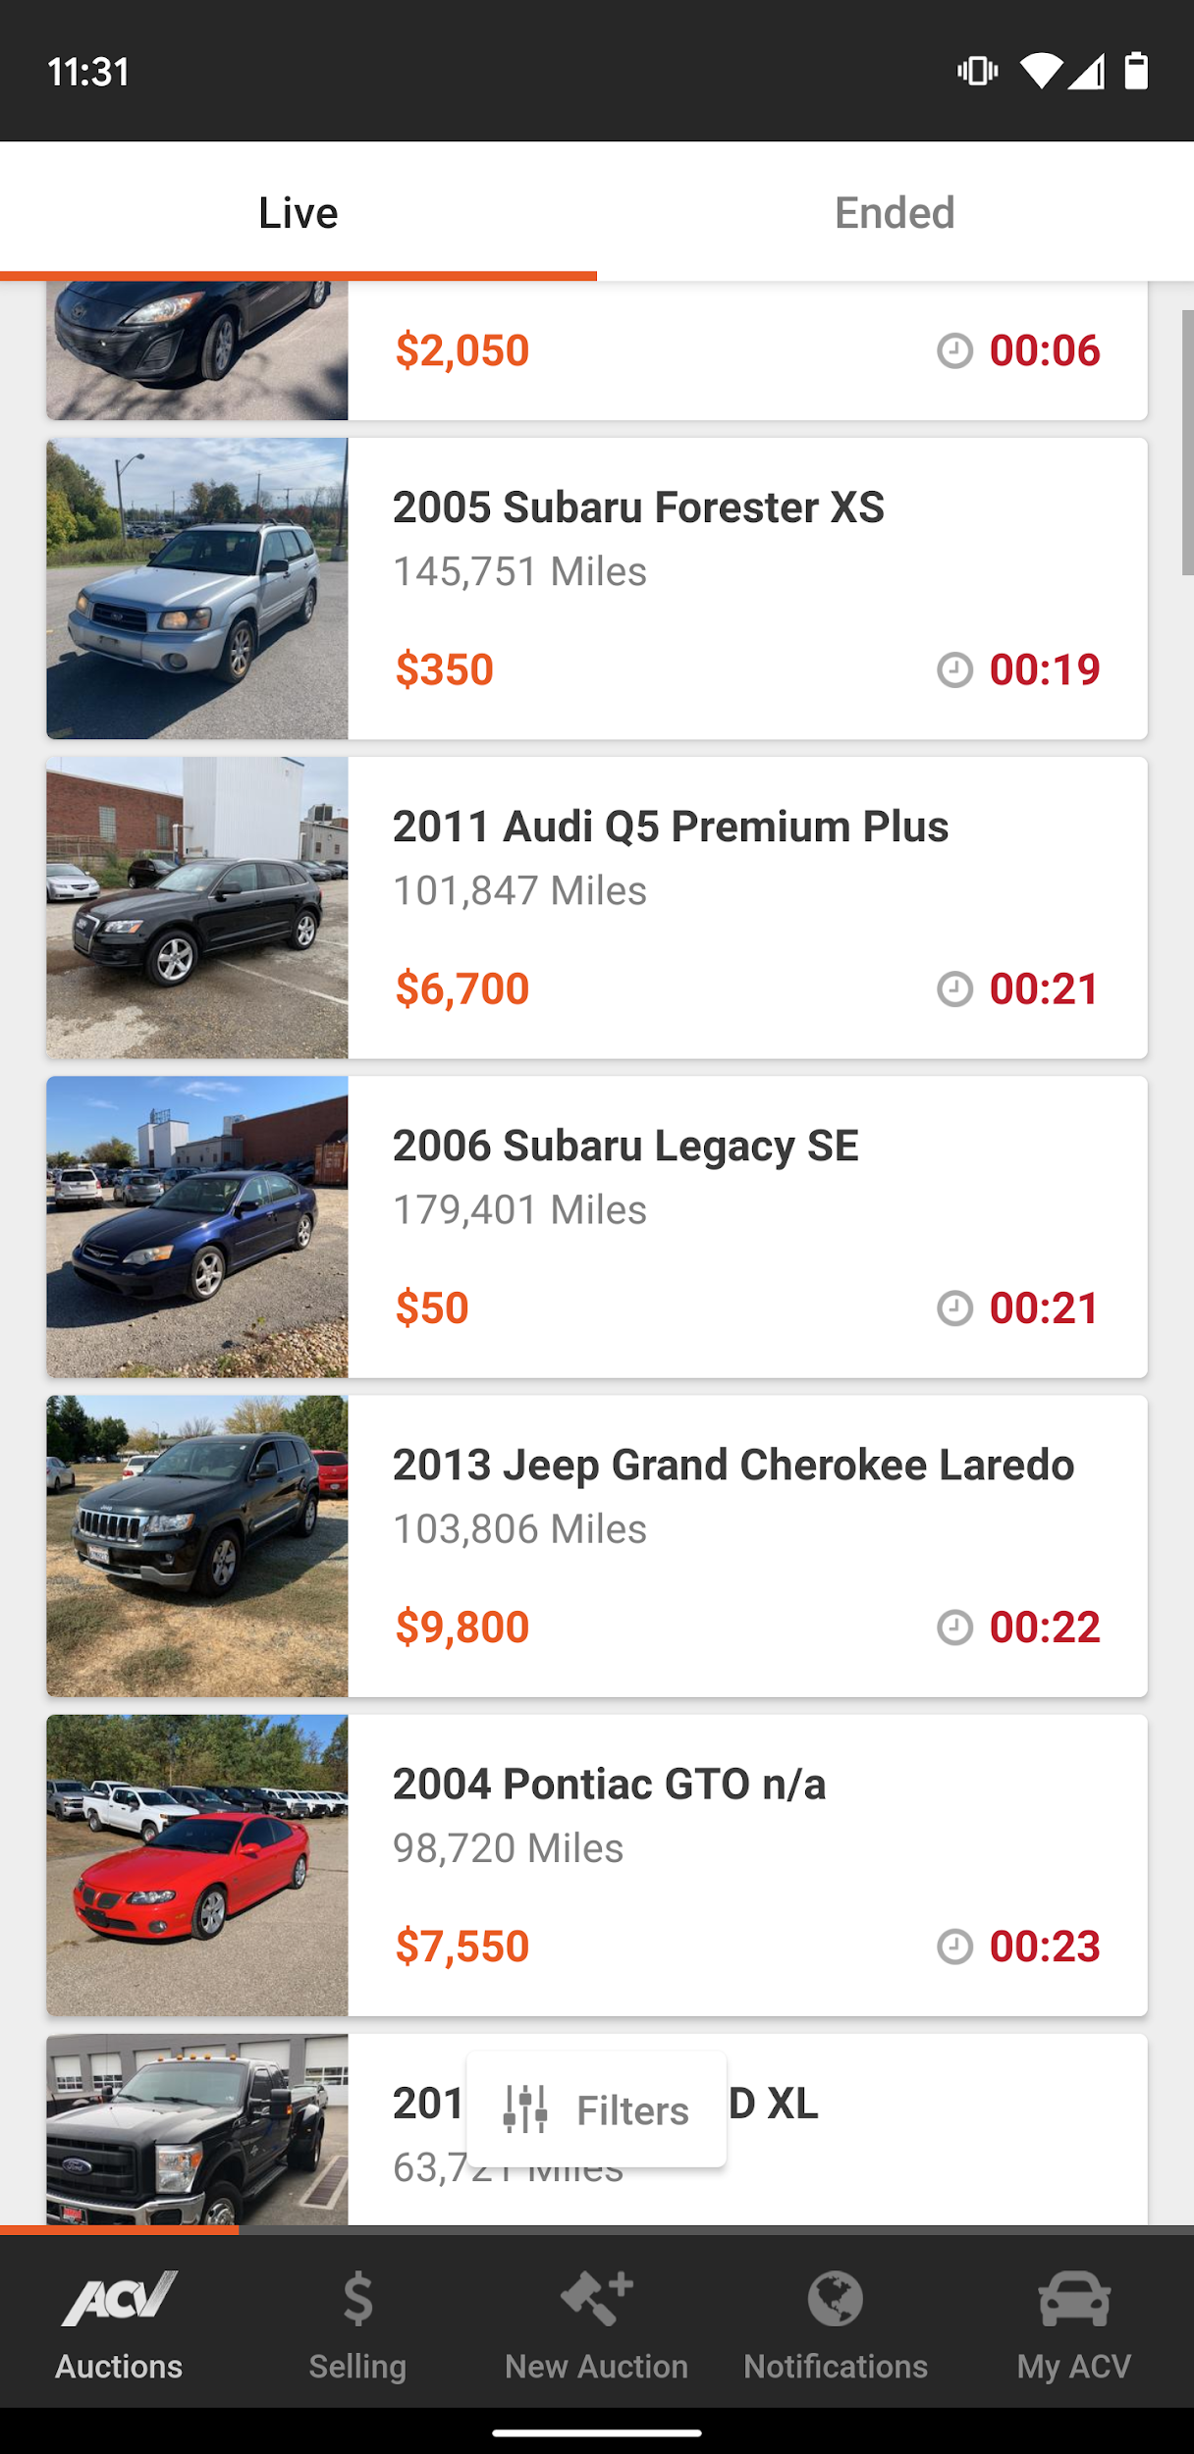
A brief history
Company founded 2014
Launched 2015
Dealer to Dealer automobile auctions
No consumer facing product.
20 minute durations
Initially only offered Titanium app
iOS
Android
Backend built on Perl and Node.js
No Web product beyond registration

Slide 5
A brief history
Customers requested a web site
Multitasking
Researching vehicles.
Bidding on multiple vehicles.
Older demographic
Faster iteration on updates
Faster conversion rate

Slide 6
A brief history
The Legacy Angular App
AngularJS 1.4
AuctionHouse SDK
JavaScript Library
Powered the Titanium Apps
PHP Middle Tier
Serve static assets
Session data
Proxy to Backend API

Slide 7


The Dreaded ‘R’ Word...
Your product manager
REWRITE!

Slide 8

To rewrite or not to rewrite.

Slide 9
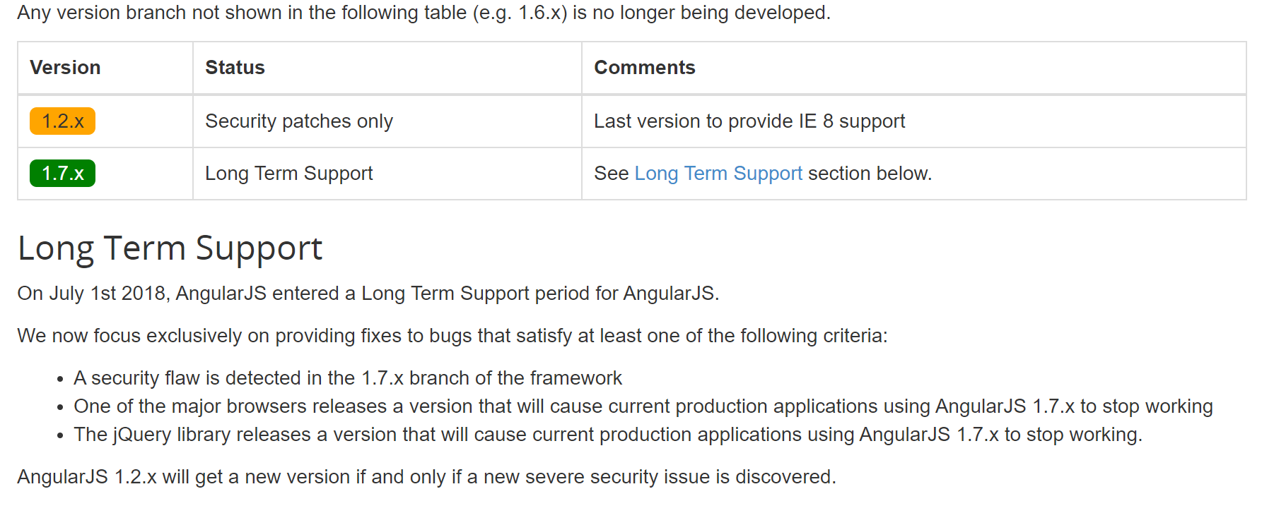
To rewrite or not to rewrite
AngularJS End-of-life
Long-term-support July 1st, 2018 - July 1st, 2021
https://docs.angularjs.org/misc/version-support-status#long-term-support
https://bit.ly/2LXU89J

Slide 10
To rewrite or not to rewrite
State of our code
Built in under 2 months
Single developer
Lack of best practices
No Documentation
No Unit/E2E testing
Tightly coupled to legacy SDK
Deprecated with shift to native apps

Slide 11
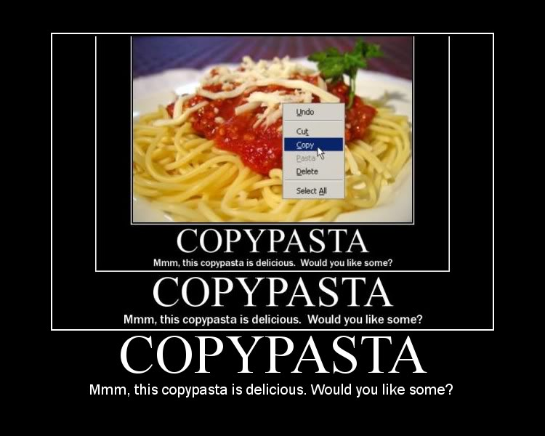
To rewrite or not to rewrite
Developer quality of life
Lack of build system
Debugging Difficult
Business rules undocumented
Susceptible to side effects
Lack of quality dev tools
Copy/Pasta’d code and CSS

Slide 12

Cost of a rewrite

Slide 13
Cost of a rewrite
Onboarding
3-6 months before experienced engineers become productive
Juniors struggle
New Features
From design to production
Started 2-3 months
Ended 6-9 months

Slide 14
Cost of a rewrite
Supporting Existing Features
Increase in
Bugs reported
LSI’s
Error Rates
Time to diagnose/deloy fix

Slide 15
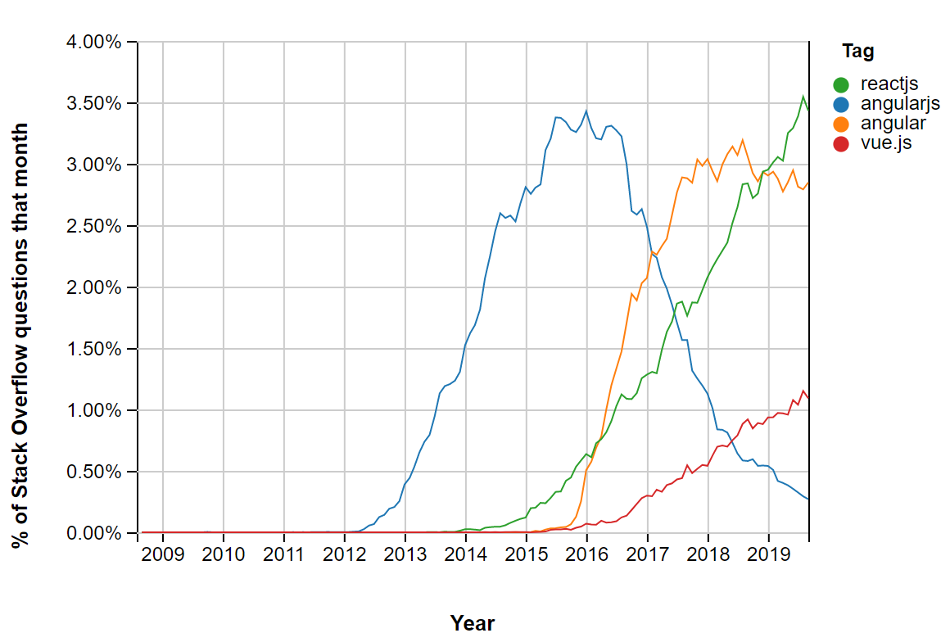
Cost of a rewrite
Attracting Talent
Growth Period
Attracting top talent difficult
Older tech not attractive
Source: Stack Overflow - https://bit.ly/2OR4Wse

Slide 16
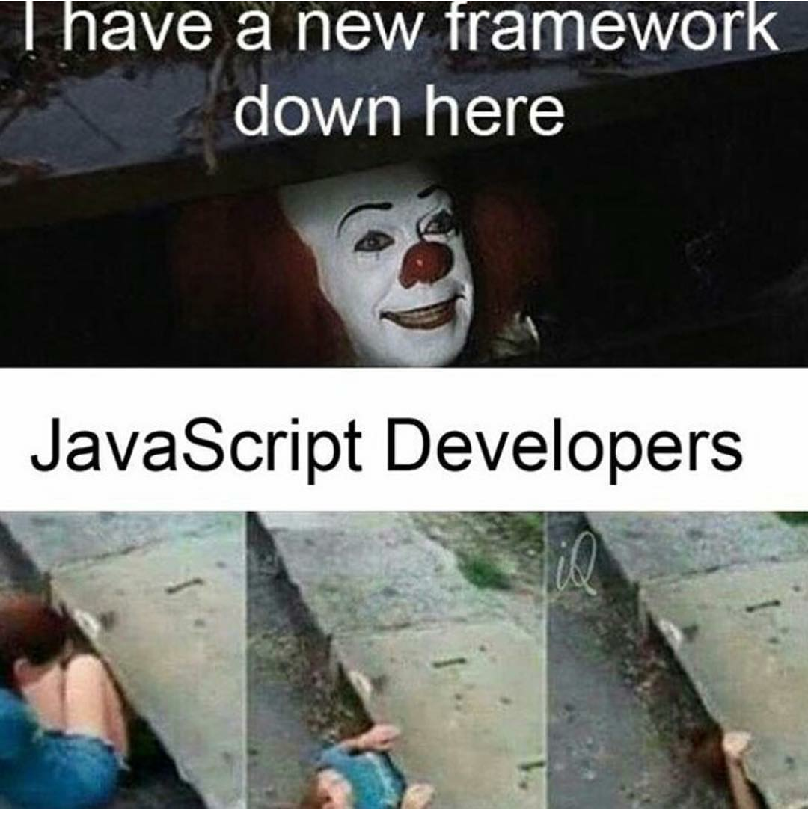
How we decided on Vue.js

Slide 17



Selection Process
3 Frameworks
React
Angular 5
Vue.js
Centralized State
Flux/Redux/Vuex
Proof of concept
Auction List

Slide 18
Vue.js
Pros
Similar syntax
v-if/ng-if
v-show/ng-show
v-for/ng-for
Ease of setup and deployment
Vue CLI
Single file components
Single responsibility
Easier re-use

Slide 19
Vue.js
Cons
Not developed by a major company
Not as widely adopted as React or Angular
Large scale applications can become difficult to maintain/manage

Slide 20

Measuring Success (and failure)

Slide 21

Measuring Success
Define and honor a delivery date
July 22 2019
Deliver within 1 week of committed delivery date

Slide 22
Measuring Success
Improve app performance
Page load times < 1 second
APDEX
Set for 2 seconds
BrowserInteraction duration
3 seconds

Slide 23
Measuring Success
Observe Error Budget
1 or fewer LSI’s during life of project

Slide 24
Measuring Success
Generate Robust documentation
Implement Storybook component library
Include documents on each component
Documentation generated for each release

Slide 25
Measuring Success
Improve unit test coverage
> 30%

Slide 26
Our Architecture

Slide 27
Legacy System
Grunt
Uglify minified static assets
Manually linked JS/CSS
Web servers
Load Balanced
Docker containers
NGINX
PHP

Slide 28
Legacy System
Redis instance
Session Data
Client storage
PHP cookie for session data
localStorage for misc data

Slide 29
Vue System
Vue CLI 3
Webpack 4
Babel
.env configs
Web servers
Load Balanced
Docker containers
NGINX
Service Worker/PWA Support
Pre-cache static assets
Handles application updates.

Slide 30
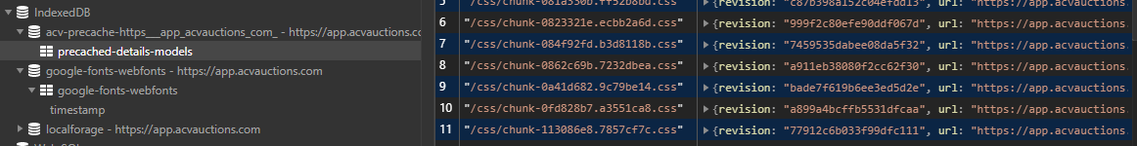
Vue System
Client Storage
localStorage
IndexDB
Service worker cache

Slide 31

Angular/Vue Integration

Slide 32
Integration
Git submodule
Vue repo as submodule of Angular repo
Clear separation of legacy code
No risk of accidental coupling
Can expose Vue components to Angular

Slide 33
Integration
Git submodule
Separate deployments
Easier local development
Cleaner cutover once migration is complete.
Less tech debt.

Slide 34
Integration
Feature Development
All new features in Vue
Limit feature duplication when possible
Expose Vue components via iframe
Components prop-based (no Vuex)
Window events for communication
Ex: AMP Audio Player

Slide 35
Integration
Service Worker
Vue CLI PWA plugin
Pros:
Cache layer
Improve load times
Background updates
Prompt for reload
Force refresh

Slide 36
Integration
Service Worker
Cons:
Increased complexity
Difficult to debug/test

Slide 37

OKR Results

Slide 38

OKR Results
Define and honor a delivery date
July 22 2019
Deliver within 1 week of committed delivery date
Result:
Sept. 10th 2019

Slide 39

Measuring Success
Improve app performance
Page load times < 1 second
APDEX
Set for 2 seconds
BrowserInteraction duration
3 seconds
Results:
Time-to-first-byte
0.1 - 0.3 secs
3-4 seconds total
APDEX
0.75
BrowserInteraction duration
5.89 seconds

Slide 40

Measuring Success
Observe Error Budget
1 or fewer LSI’s during life of project
Results
1 LSI
SEV 3

Slide 41
Measuring Success
Generate Robust documentation
Implement Storybook component library
Include documents on each component
Documentation generated for each release
Results:
Completed
Internally hosted
Completed
Release document generator

Slide 42

Measuring Success
Improve unit test coverage
> 30%
Results:
43%

Slide 43

Summary

Slide 44

Tom Colarusso
@etcolarusso
@acvauctions
Questions?
www.acvauctions.com

